Slide 1

Guidance on the Register of Apprenticeship Training Providers (RoATP)
Bryony Kingsland
UK Funding Manager
9 November 2016

Slide 2
AGENDA
Three routes to applying for the RoATP
Which route is right for you?
Reasons not to apply
What you need to do before you apply
E-bravo Tendering Portal explained
Financial health assessment – spreadsheet
Compliance, capability and capacity, quality
Hints and tips for success
Supporting documents + how City & Guilds can help further
Q&A

Slide 3
REGISTER OF APPRENTICESHIP
TRAINING PROVIDERS
The application process for entering the new register will close on 25 November 2016 at 5pm.
There are three routes for application. You should apply to one route only and choose the most appropriate for your needs:
Supporting route
Entry route to the apprenticeship market for organisations that
offer a specialism or providers who only wish, or have the capacity, to deliver as a sub-contractor.
Main route
Eligible for selection by levied employers, or selection by another main provider to work as a subcontractor.
Employer-provider route
Employers who want to deliver apps to their own staff. They will have the flexibility to lead their own programme, or act
as a sub-contractor to their appointed main provider.
RoATP

Slide 4
WHICH ROUTE
IS RIGHT FOR YOU?
Main Provider Route:
Organisations that deliver directly to employers.
Levied employers that want to deliver to their own staff, organisations in their supply chain or other organisations.
Organisations that wish to deliver to non-levied employers via a procured contract with
the Skills Funding Agency (SFA) (current Invitation to Tender (ITT)).
Organisations who have the capacity to deliver a substantial part of their
apprenticeship offer.
There are extensive due diligence requirements for any main provider considering
sub-contracting to other providers.
Notes:
1 - Do not have to be on ROTO to be on RoATP
2 – Doing this will enable employers to use the find and search facility on DAS and see if your offer meets their needs in their area.
3 – more about that later

Slide 5
WHICH ROUTE
IS RIGHT FOR YOU?
Supporting Provider Route:
Organisations who wish to deliver as a sub-contractor only.
Don’t have the capacity to act as a main provider.
Used as an entry route to the market.
Providers that apply to this route:
Cannot deliver more than £500k across their cumulative sub-contracts.
Must deliver apprenticeships to employers via a main provider (not directly).
Notes:
1 - Do not have to be on ROTO to be on RoATP
2 – Doing this will enable employers to use the find and search facility on DAS and see if your offer meets their needs in their area.
3 – more about that later

Slide 6
WHICH ROUTE
IS RIGHT FOR YOU?
Employer Provider Route:
For levy paying employers who wish to:
  Deliver apprenticeship to their own staff.
  Act as a sub-contractor to a main provider to deliver to their own staff.
Employer providers cannot deliver outside of their organisation, e.g. to a company
in their supply chain.
Will not be included on the Digital Apprenticeship Service Search Tool.
Will be inspected by Ofsted.
Will need to make data returns to the SFA and maintain evidence for SFA audits.
Notes:
1 - Do not have to be on ROTO to be on RoATP
2 – Doing this will enable employers to use the find and search facility on DAS and see if your offer meets their needs in their area.
3 – more about that later

Slide 7
REASONS NOT
TO APPLY
You do not intend to deliver apprenticeships.
You have been trading as a business for less than three months.
You have an Ofsted grade 4 for ‘delivery of apprenticeship provision’ in last three years.
You have Ofsted grade 4 for ‘overall effectiveness,’ unless you have a grade 3, or above, for ‘delivery of apprenticeships.’
You will deliver less than 100k of apprenticeships in the year.
You have scored less than satisfactory on the Financial Health Assessment.
Notes:
1 - Do not have to be on ROTO to be on RoATP
2 – Doing this will enable employers to use the find and search facility on DAS and see if your offer meets their needs in their area.
3 – more about that later

Slide 8
BEFORE YOU APPLY
TO THE REGISTER
YOU MUST HAVE REGISTERED WITH:
The UK Register of Learning Providers
https://www.ukrlp.co.uk/
Information Commissioners Office (ICO) for education and training.
https://ico.org.uk/
For an account on the Bravo E-Tendering portal
https://skillsfundingagency.bravosolution.co.uk/web/login.shtml
Notes:
1 - Do not have to be on ROTO to be on RoATP
2 – Doing this will enable employers to use the find and search facility on DAS and see if your offer meets their needs in their area.
3 – more about that later

Slide 9
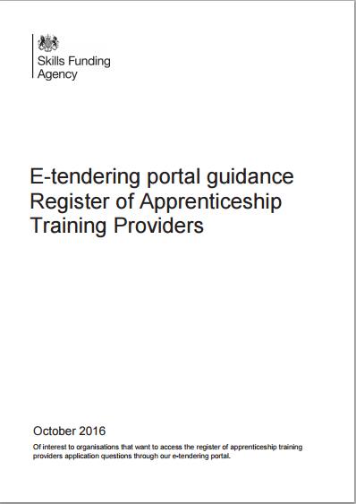
SUPPORT
DOCUMENTS
https://www.gov.uk/government/publications/register-of-apprenticeship-training-providers-e-tendering-portal-guidance
Includes support information for accessing the RoATP
Also for accessing the Invitation to Tender (ITT)
for non-levy paying SFA contracts

Slide 10
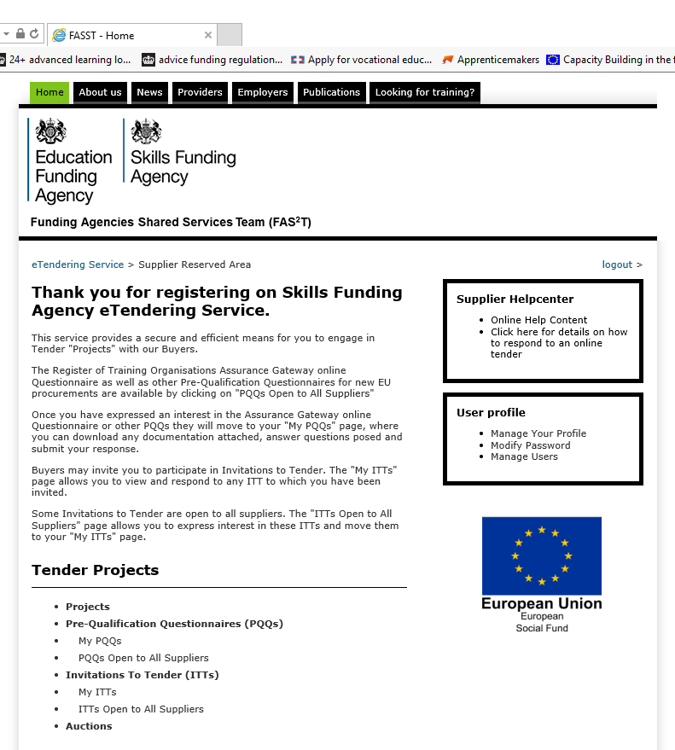
E-BRAVO
TENDERING PORTAL
The portal to apply for entry to the RoATP, and to respond to ITT’s for contracts to deliver to non-levied employers.
Bravo Solutions video assistance –
responding to online tenders.
http://www.screencast.com/t/ZjZkZDZh
PQQ 28910: Main route - register of apprenticeship training providers.
PQQ 28911: Employer provider route - register of apprenticeship training providers.
PQQ 28912: Supporting route - register of apprenticeship training providers.

Slide 11
FINANCIAL HEALTH
ASSESSMENT
Must score satisfactory at least to continue.
Upload most recent financial statements or management accounts.
Some organisations do not need to complete the FHA, as their financial data is already in the public domain. Those organisations are:
  General FE Colleges.
  Local Authority including LEA Schools, free schools
  and academies, 6th Form Colleges.
  Universities monitored by HEFCE.
  Government departments, non departmental bodies
  or executive agencies.
  NHS Trusts and Fire Authorities.
Notes:
Very useful and helpful guidance on first tab of the sheet. This document is very clear – failure to comply with req’s will result in an inadequate grading.
Latest Final financial statements will be signed by Director, Accountants or auditors
Must get Satisfactory, good or outstanding to continue.
Mgmt accts include – profit and loss, balance sheet and relevant notes

Slide 12
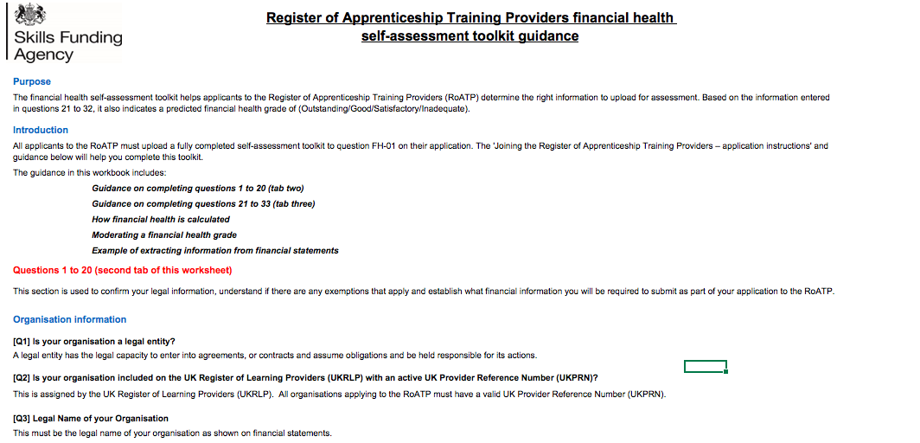
FINANCIAL HEALTH
ASSESSMENT
Find out more here: https://www.gov.uk/government/publications/register-of-apprenticeship-training-providers-application-instructions

Slide 13
COMPLIANCE
This relates to your organisations legal position, e.g:
Insolvency or
equivalent
proceedings.
Senior managers /
directors / trustees
legal and financial
positions.
Possible
legal or
contractual
disputes.
Confirmation
of liability
insurance
and other
insurances.
Notes:
Main providers must make sure that they are tracking all the contracts a sub has across all main providers so the cumulative funding for that sub does not exceed the threshold.
One a supporting provider reaches the 500K threshold, they must apply to the register as a main provider.

Slide 14
CAPABILITY
AND CAPACITY
All applications must include their safeguarding policy - main providers must specify how you put this into practice.
Main and supporting providers must include their Prevent Duty policy and practices.
Prevent and safeguarding support resources
For levy paying employers who wish to:
Prevent duty
https://www.gov.uk/government/publications/prevent-duty-guidance
Education and Training Foundation support resources http://www.preventforfeandtraining.org.uk/
Notes:
PREVENT - your understanding of your organisation’s responsibilities to prevent people from being drawn into terrorism - specified under section 26 of the Counter-Terrorism and Security Act 2015
SAFEGUARDING - looks at keeping children, young people and vulnerable adults safe from a wide range of potential harm, and looks at your preventative actions, not just reaction.

Slide 15
CAPABILITY
AND CAPACITY
Main and employer providers must include information about:
Health and safety policies.
Equal opportunity policies.
Anti bullying, anti discrimination and promotion of diversity policies.
How you will submit ILR data to the SFA.
Business continuity plans – main route providers only.
Any issues with previous apprenticeship delivery.
Notes:
BUSINESS CONTINUITY – how you will minimise disruption to apprenticeship training
ILR – Organisations applying through the main and employer provider routes must have a management information system in place at the point they begin delivery. This must be able to produce an ILR XML file that meets the requirements of the ILR specification (XML File - XML is a file extension for an Extensible Markup Language (XML) file format used to create common information formats and share both the format and the data on the World Wide Web, intranets, and elsewhere using standard ASCII text. Similar to HTML
An ILR learner entry tool is available for download and supports returns for up to 500 learners. This software is free to organisations that submit data to the SFA and do not have access to a data management system. You can download the tool from the useful links area on the front page of the Hub. A user guide is available on the ILR page on GOV.UK. You can only use this software with Windows operating systems.

Slide 16
QUALITY
Ofsted inspection outcomes (or QAA, if HEI), including apprenticeship delivery, teaching and learning and overall effectiveness gradings.
Leadership and management.
Appropriate staff to deliver.
Performance management structure and systems.
Quality assurance.
Continuing Professional Development (CPD).
Meeting needs of employers and learners
Notes:
Links to most recent Inspection reports
Leadership and Management – structure and experience – also how they will manage performance and quality to maintain high quality provision - processes in place for this.
Staffing structure – useful/good practice to have staffing matrix in place – staff numbers in each area, qualifications and experience (partic Industry background), ongoing CPD plans and policy to ensure staff experience and knowledge remains up to date.
Management of your internal processes to ensure quality delivery – structure of perf mgmt. for staff and organisation to ensure meeting needs of employer and apprentices.
Quality Assurance and Self assessment – SA report and plans, how you measure success and use data and perf mgmt. to improve performance and outcomes – across staff, learners, equality and diversity, etc.

Slide 17
HINTS AND TIPS
FOR SUCCESS
Questions prefixed with a red asterisk (*) are mandatory. You won’t be able to submit the response if any of these are left unanswered.
Answer each question fully in the relevant text box. Don’t refer to answers given in other parts of the document, e.g. ‘Please see answer given in 2.11’. This information will not be considered as part of your answer.
Questions that require uploaded attachments, must be in the format specified. Where not specified, use widely recognised formats, e.g. PDF, Excel, Word documents and image files. Mac and equivalent files cannot be accepted.
Some answers limit the number of characters you can use in your response.

Slide 18
HINTS AND TIPS
FOR SUCCESS
Checklist to ensure upload of all supporting documents
Read the Application Instructions fully before starting.
Ensure you fully complete all relevant questions in document sections
Ensure you have uploaded your most recent financial statements, if required
Upload completed application well before the deadline – you have until 5pm on 25th November to amend.
Proof-read all your completed documents and application before uploading
Don’t leave final upload to the last minute! Technology doesn't always play ball!!
Notes:
Application may fail if there is evidence of convictions relating to specific criminal offences including, but not limited to, bribery, corruption, conspiracy, terrorism, fraud and money laundering.

Slide 19
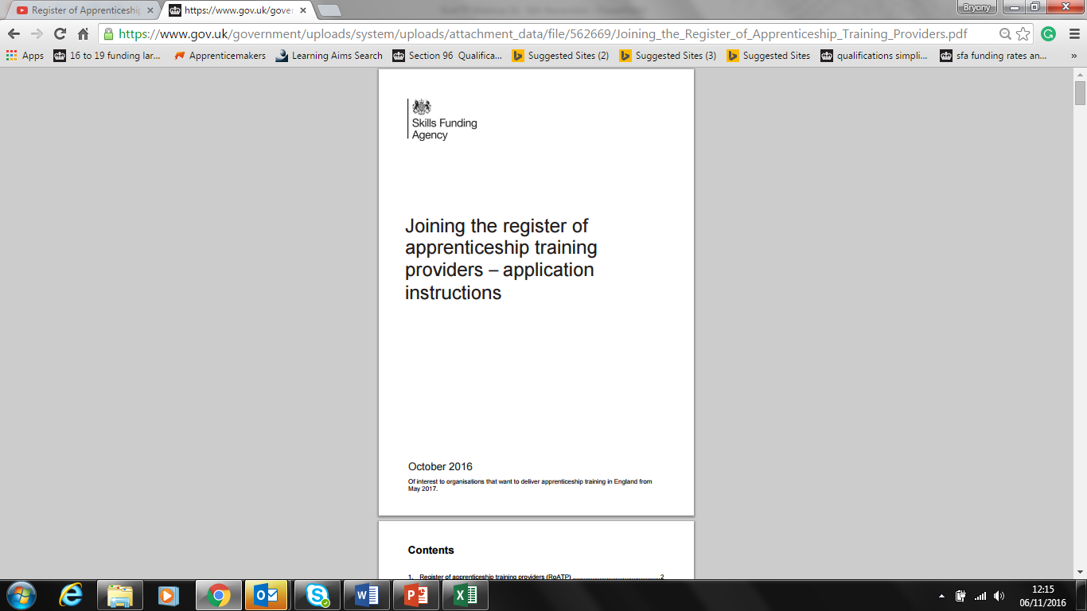
SUPPORT
DOCUMENTS
Guidance document and financial health assessment spreadsheets
https://www.gov.uk/government/publications/register-of-apprenticeship-training-providers-application-instructions

Slide 20
REGISTER OF APPRENTICESHIP
TRAINING PROVIDERS
We can offer:
Detailed advice and guidance on applications to RoATP.
Reviewing your RoATP application and recommendations for improvement.
Test the rigour of your organisation's processes and systems against best practice due diligence requirements.
Identify gaps in current processes and systems, including management information and reporting.
Early in 2017, we will be running workshops covering:
Funding arrangements in detail.
Planning for delivery.
ILR changes.
Performance management arrangements.
For further details please contact
Nicole.Butler@cityandguilds.com
Notes:
Three routes depends on what type of provider you are or want to be

Slide 21

Thank you for participating
Q&A
Notes:
So this is where it get a bit more complicated. But in 7 months I’m sure it will all have become clear!!

